Slide 1
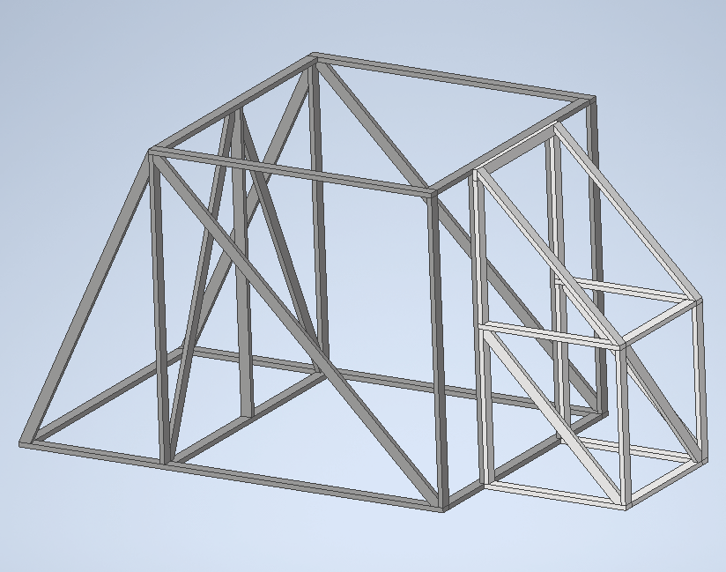
Base 3
20 2x4x8
5 2x4x10
6 2x4x12

Slide 2
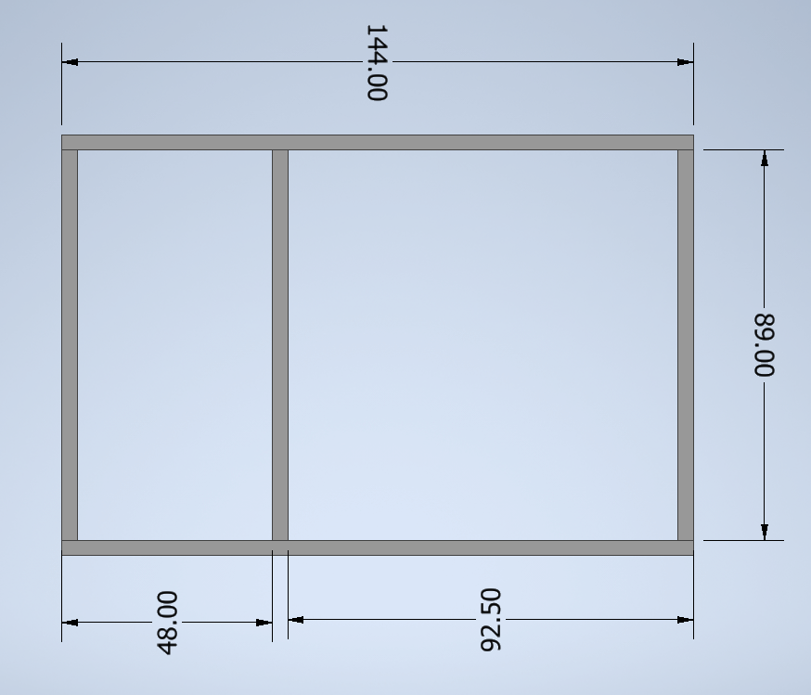
(2) 2x4x12
(2) 12’
(3) 2x4x8
→ (3) 7’5”

Slide 3
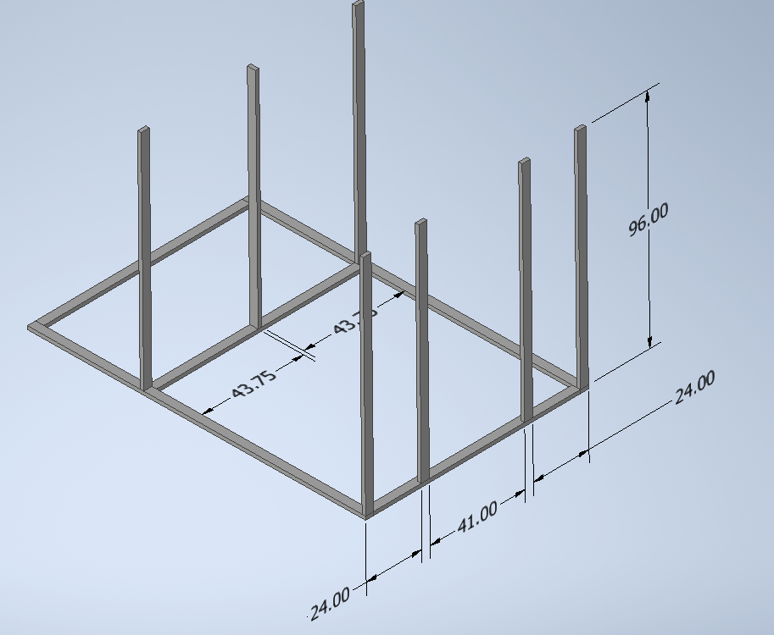
(7) 2x4x8
→ (7) 8’

Slide 4
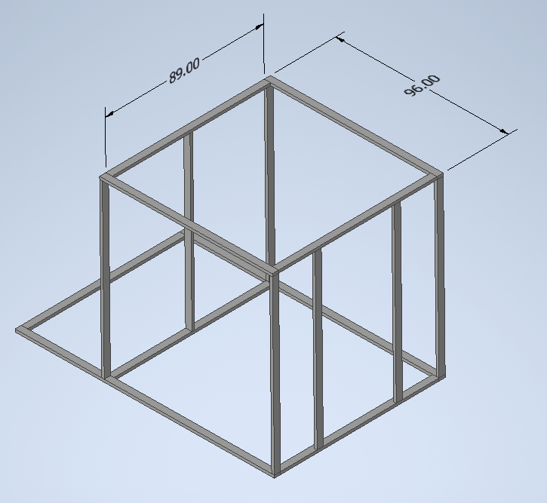
(2) 2x4x8
(2) 8’
(2) 2x4x8
→ (2) 7’5”

Slide 5
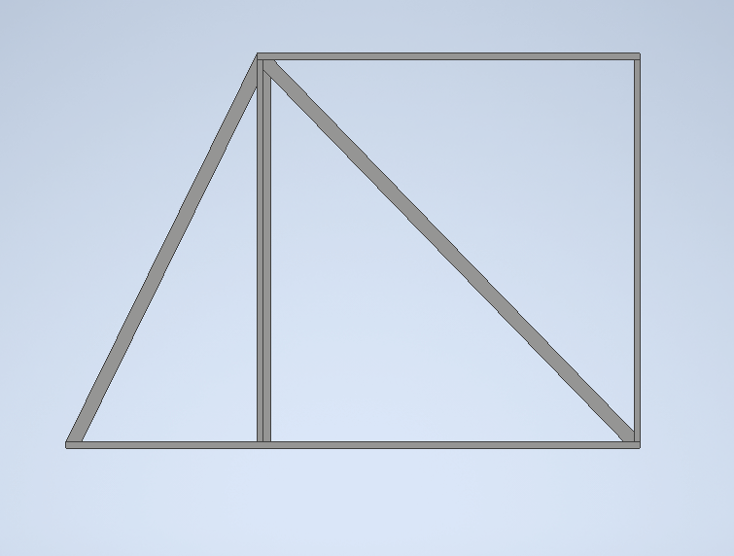
(2) 2x4x12
(2) internal slants
(2) 2x4x10
(2) external slants

Slide 6
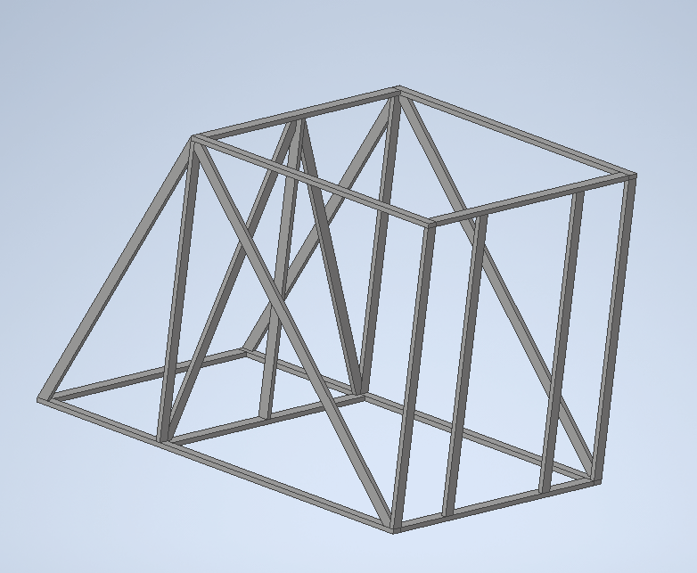
(2) 2x4x10
(2) slants

Slide 7
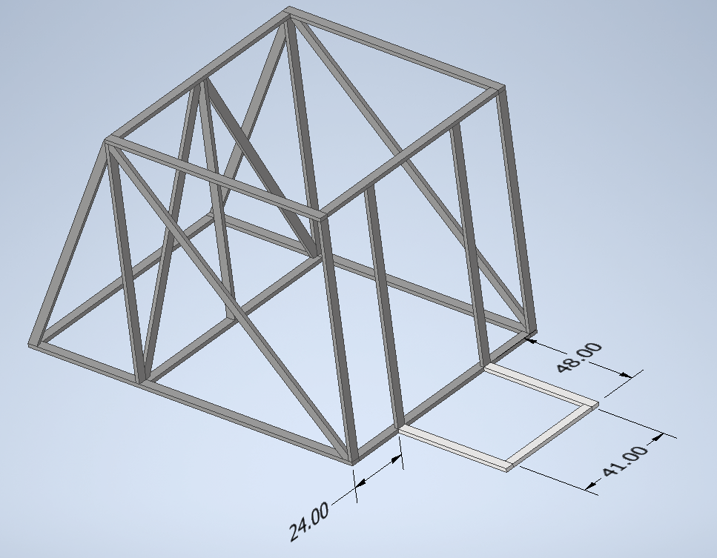
(1.5) 2x4x8
(2) 4’
(1) 3’5”
  save other half for top piece

Slide 8
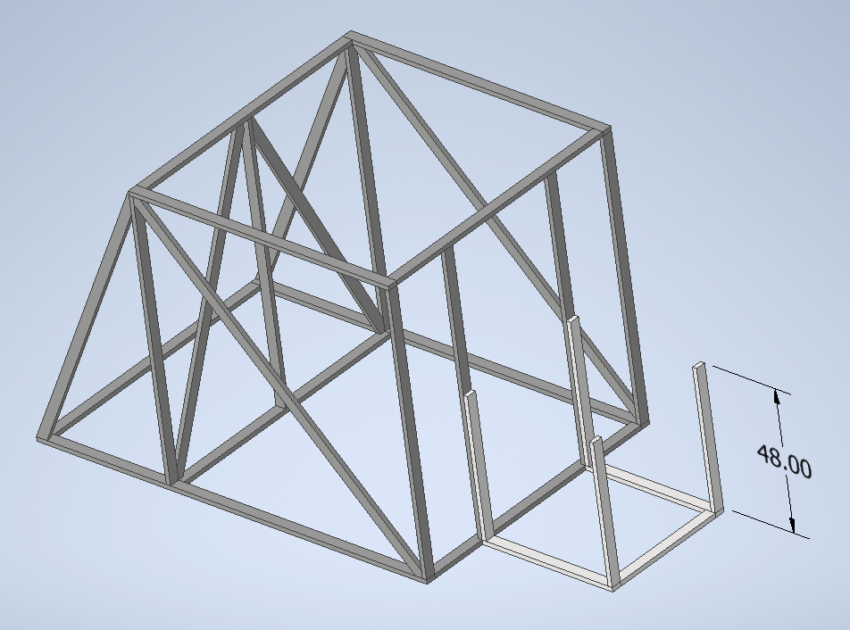
(2) 2x4x8
(4) 4’

Slide 9
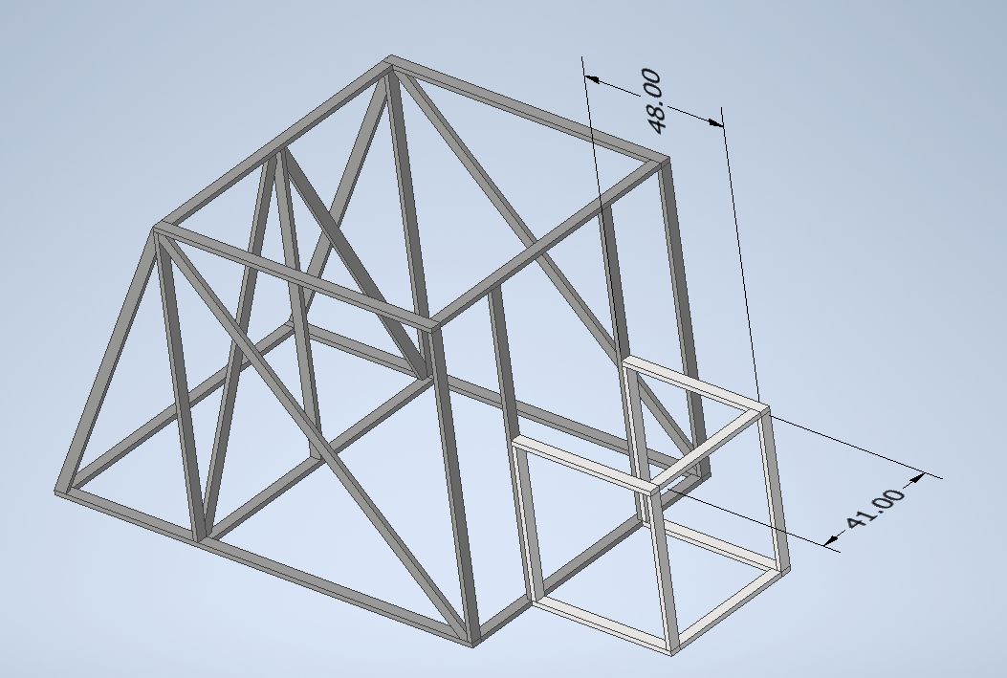
(1.5) 2x4x8
(2) 4’
(1) 3’5”
  from other half of bottom piece

Slide 10
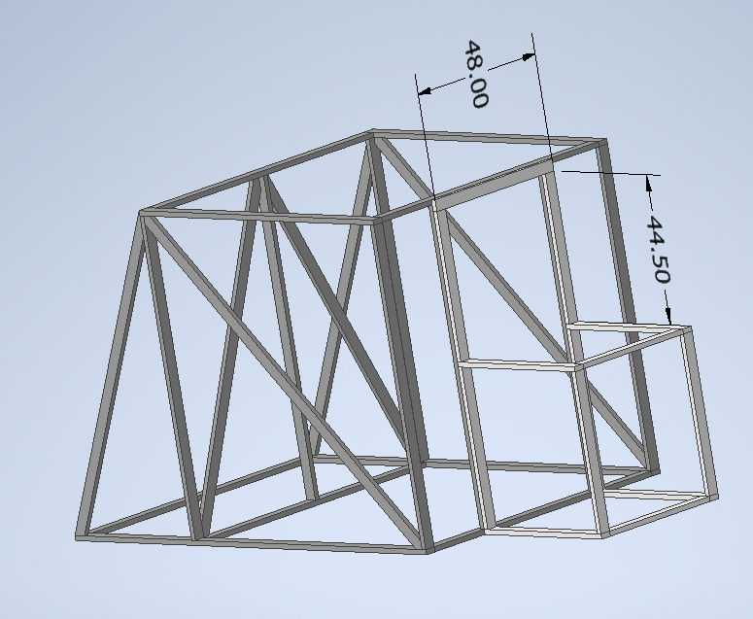
(0.5) 2x4x10
(1) 4’
  save other half for front slant
(1) 2x4x8
(1) 3’8.5”

Slide 11
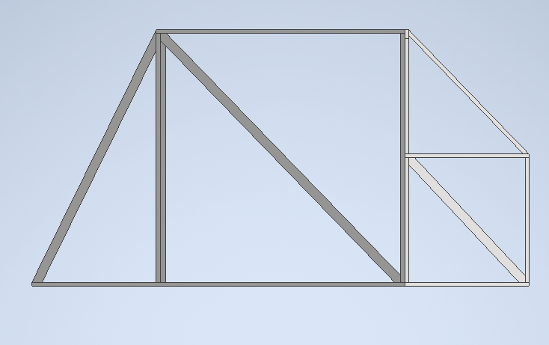
(2) 2x4x12
(4) slants

Slide 12
(0.5) 2x4x10
(1) slant
  Saved from other half of top piece

